Slide 1
Florian Robrecht · Janin Jankovski · Anna Hartmann
Reinforcement learning
4
with 2048
8
16
Machine Learning 2 · Assignment 5 · Group 5
2048
2
Notes:
Hi everyone. Welcome. We're going to talk today about teaching a computer
to play the puzzle game 2048, and what happens when you put a modern deep-
learning method head-to-head with a classical method from the 1980s.
A quick spoiler: the classical method wins, decisively, and the *why* turns
out to be the most interesting part of the whole project.
I'm Florian, with Janin and Anna — this is our Machine Learning 2 Assignment 5.

Slide 2
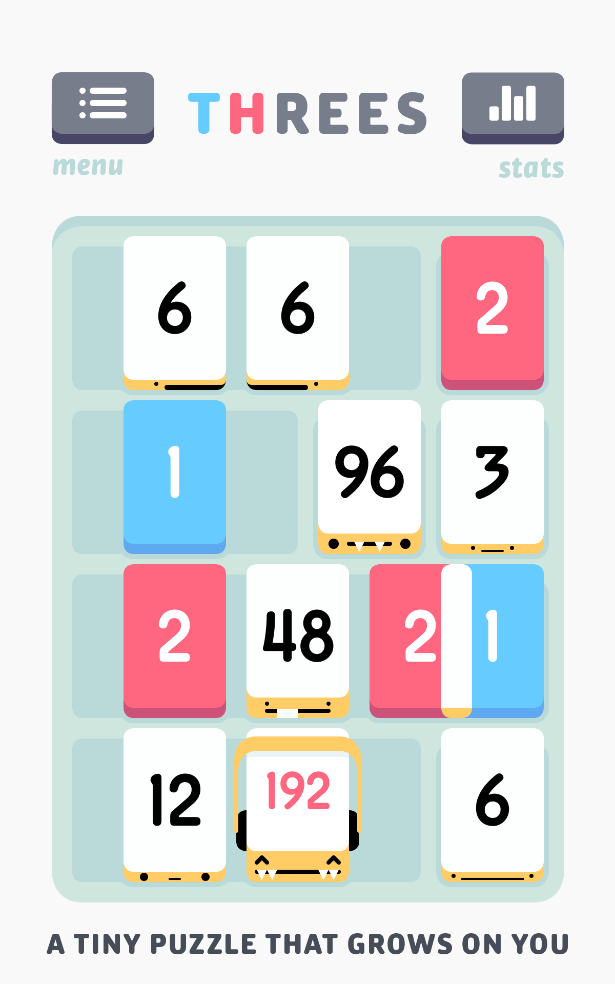
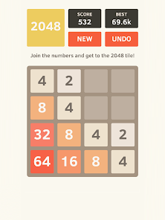
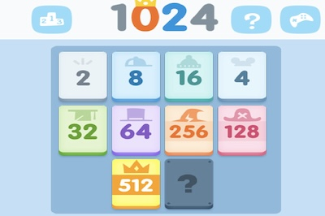
A short history of 2048
Built in a weekend, viral in a week
2014
Year created
19
Age of creator
48 h
From idea to release
4 M+
Players in week 1
• Created by Gabriele Cirulli at age 19 (Milan) — open-source on GitHub, March 9, 2014
• Cirulli built it in about a day and a half as a personal challenge — he wanted to see if he could program a game from scratch
• Inspired by Threes! and the earlier 1024
• Theoretical maximum tile: 131,072 = 2¹⁷ — no one has reached it in fair play
• Within a week of launch, 2048 had been played by over 4 million people. Within a month, it hit ~100 million players
• Sparked an entire research literature on n-tuple TD learning (Szubert & Jaśkowski 2014 onwards)
02 / 19
Notes:
Some quick context. 2048 is one of the most-played puzzle games of the 2010s.
It was made by Gabriele Cirulli, who was 19 at the time. He built it in a
weekend, put it on GitHub, and within a week it had four million users.
What makes this game interesting for *machine learning* is the long history
it has with classical algorithms. The strongest non-search agents ever
recorded for 2048 were built in 2014 by Marcin Szubert and Wojciech
Jaśkowski, using a method called *n-tuple temporal-difference learning*.
That method predates the deep-learning boom by years.
The theoretical maximum tile is 131,072 — that's 2 to the 17th. Nobody
has reached it in fair play, even with hours of computer search.
The reason we're doing this experiment: it's an obvious-feeling 2026 move
to throw a deep neural network at 2048 and see if it beats the classical
method. So that's what we did.

Slide 3
The rules
Slide, merge, repeat — until 2048 or until the board fills up
• 4×4 grid, swipe up, down, left or right · every tile slides as far as it can in that direction
• Two tiles with the same number that collide merge into one tile of double the value
• After every swipe a new 2 (90 %) or 4 (10 %) appears in a random empty cell
• Win at 2048 · Lose when the board is full with no legal merge
2
2
4
4
4
8
2
2
swipe →
4
swipe →
Simple merge: two 2s become a 4
Two merges in one swipe (no chaining of new tiles)
03 / 19
Notes:
The rules are simple. You have a 4-by-4 grid. You swipe in one of four
directions — up, down, left, right — and every tile slides as far as it can
in that direction.
When two tiles with the *same* number collide, they merge into one tile of
double the value. So two 2s become a 4, two 4s become an 8, and so on.
After every swipe, a new tile appears in a random empty cell. Usually a 2
(90 % of the time), occasionally a 4 (10 %).
You win if you ever build the 2048 tile. You lose when the board fills up
and no merges are possible.
Look at example 2 on the right. You can get *two* merges in a single swipe
if you set them up right — that pair of 2s becomes a 4, and that pair of 4s
becomes an 8, all in one swipe. But there's a subtlety: those new tiles
don't *chain*. The new 4 doesn't merge with the new 8 in the same swipe.
That makes the game easier to reason about — every swipe is bounded.
We implemented this with a bitboard — each row of the board packs into
16 bits, so all 65,536 possible row configurations fit in a lookup table.
Move logic is then just four table reads per swipe. Very fast, and we
unit-tested it against a naive implementation across every possible row.

Slide 4
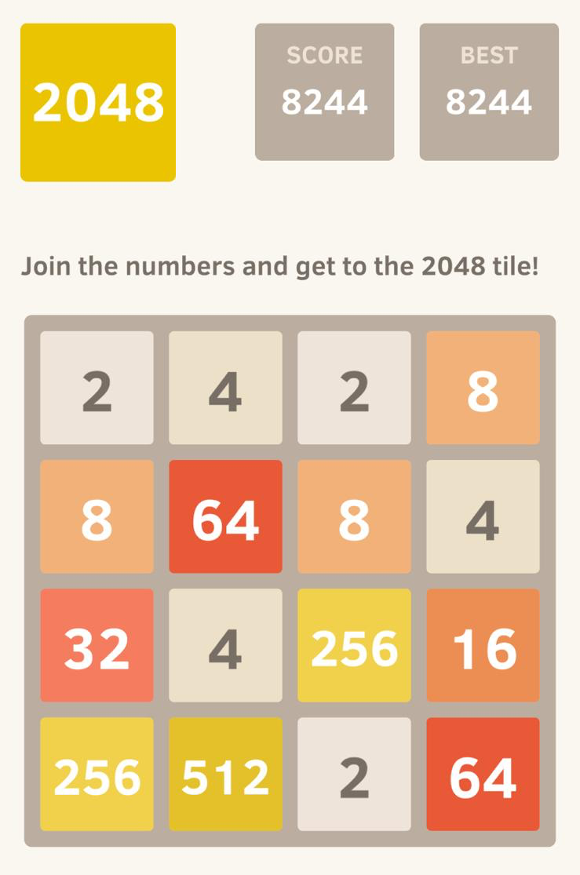
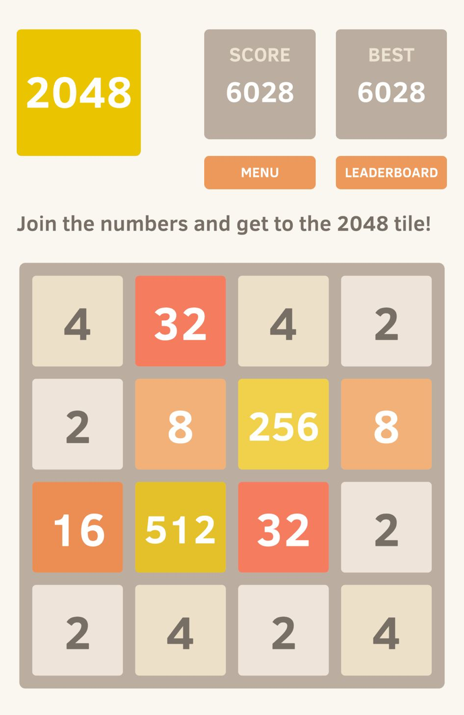
Our First Try
Anna, Flo & Janin
Anna Flo Janin
04 / 19

Slide 5
What is reinforcement learning?
An agent learns by trial and error — no labelled answers
STATE
what the agent sees (the board)
ACTION
what the agent does (swipe direction)
REWARD
what the agent gets (merge points)
The agent updates its strategy from rewards. No teacher, no labels.
• Every move gives the agent feedback (points scored on this move)
• Over many games the agent learns which moves tend to lead to high total scores
• The hard part: how to remember good moves when no two boards are ever quite the same
05 / 19
Notes:
Before we talk about our agents, let me explain *reinforcement learning*
in plain language, in case it's new to you.
Reinforcement learning is the branch of machine learning where the computer
learns by trial and error. The setup is a loop:
1. The agent looks at the current STATE — in our case, the board.
2. It picks an ACTION — a swipe direction.
3. It gets a REWARD — the points it scored on that move.
4. Then it sees the new state, and the loop repeats.
After playing thousands of games, the agent learns which moves tend to lead
to high total scores. There's no teacher telling it "this is the correct
swipe" — nobody labelled the data. The agent figures it all out from the
rewards it observes.
The hard part is generalization. A 2048 board can take 16 to the 16th
configurations — that's about 18 quintillion possible boards. Nobody can
memorize a strategy for each one. So every learning agent has to define
its own notion of "boards that look similar should be treated similarly."
Our two learners — DQN and n-tuple — do this in very different ways.
That's the experiment.

Slide 6
What we built
One game engine, four agents, one evaluation harness
Game engine
Tile stored as log base 2 65k-row Look Up Table (unit-tested)
4 agents
Random · Greedy DQN · N-tuple
Training
Separate loops for DQN & N-tuple
Evaluation
Hundreds of games seeded test set
Every agent implements act(board, legal_mask) → swipe — so the evaluator can swap them freely
Same environment, same evaluation, same metrics → fair comparison
06 / 19
Notes:
Quick map of what we actually built.
First:
The game engine is built for speed. Every tile is stored as its logarithm base 2 — so an empty cell is 0, a 2 is 1, a 4 is 2, an 8 is 3, and so on up to 32768, which is 15. That gives 16 possible values per cell (0 to 15). A row has 4 cells, and since each cell can independently be any of those 16 values, the number of possible rows is 16⁴ = 65,536. Each row can therefore be turned into a single number that identifies it uniquely. We precompute the result of every possible move on every one of those 65,536 rows once, into a lookup table. After that, making a move is a table lookup instead of a calculation — which is what lets us play millions of games quickly. And it's unit-tested, so the shortcut is verified correct.
Second: four agents. Two baselines (random and a hand-coded heuristic) and
two learners (DQN and n-tuple). All four implement the same interface — given
a board and a list of legal swipes, return a swipe.
Third: separate training scripts for the two learning algorithms. DQN needs replay buffer + gradient descent +
PyTorch. The n-tuple just needs NumPy and lookup tables.
Fourth: a common evaluation harness. Each agent runs on hundreds of fresh
games with the same seed that were of course *not* in training. Same engine, same protocol, same metrics so we ensure a fair comparison.

Slide 7
Meet the agents
Two baselines · two learners
Random
Greedy
DQN
N-tuple
Picks a legal swipe uniformly at random.
Hand-coded heuristic: monotonicity + empty cells + corner bonus.
Deep Q-network. 256 → 512 → 256 → 4
Lookup tables on 4 hand-picked board patches. Linear, symmetric.
Arbitrary.
Human knowledge, no learning.
Modern RL.
Classical 2048 method.
07 / 19
Notes:
Now lets quickly introduce our four agents.
RANDOM just picks a legal swipe uniformly at random. It's our "anything
worse than this is kind of broken" floor.
GREEDY is 30 lines of hand-coded rules. For each candidate swipe, it scores
the resulting board on three things:
monotonicity — are rows or columns sorted?
empty cells — more is better
and a corner bonus — extra points if the biggest tile is in a corner.
Then it picks the swipe with the highest total. Here we don’t have any learning at all. This is purely based on what humans think make a good game.
DQN is a Deep Q-Network. A neural network reads the board and learns to
predict, for each swipe, the long-term value of taking that swipe. I am going to explain this one in detail next.
N-TUPLE is the classical method from the 2014 paper. Florian will explain this one soon.
All four implement the same interface and they're swappable in the evaluator. The first two are just heuristics and the last two are learning algorithms.

Slide 8
DQN — Deep Q-Network
A neural network predicts each swipe's long-term value
2
4
256
one-hot floats
Q(↑)
8
2
4
16
2
Q(→)
32
4
Board (4×4)
Q(↓)
Q(←)
256
512
256
4
input (one-hot)
hidden ReLU
hidden ReLU
output Q-values
The network sees 256 raw numbers. No domain knowledge — it has to discover everything itself.
Trained 5,000 games (~25 min on Apple-MPS)
08 / 19
Notes:
The DQN stands for a Deep Q-Network. Since all the hype nowadays is around neural networks, we wanted to give it a try for the 2048 game.
So the Plain idea is that: A neural network looks at the board and predicts, for each of the four swipes, how many points you'll score in the long run if you make that swipe. The agent then picks the swipe with the highest predicted value.
The 'Q’ in the name stands for the Q-value, which answers the question: 'if I'm in this board state and I swipe in this direction, how much total reward will I get, counting all the future moves too?’
The architecture is a small fully-connected neural network.
The INPUT is the 4-by-4 board encoded as a one-hot tensor as we will see on the next slide.
The architecture itself is nothing fancy — a feedforward fully connected network with two hidden layers (512 and 256 neurons, ReLU activation).
This specific architecture we chose due to what we learned with greg with a pyramid shape as a classic heuristic that encourages the network to summarize rather than memorize. Two hidden layers is shallow so that it doesn’t become unstable but has enough capacity to learn
The OUTPUT layer has 4 neurons — one per swipe direction.
Critically: the network has no domain knowledge built in. It doesn't know what a "tile" is, what a "merge" is, what a "corner" is — it just gets 256 floats and four output buckets, and it has to figure out the rest from playing the game.
We trained for 5 000 games — about 30 minutes on a Mac GPU.
MLP – Multi-layer perceptron: fully-connected neural network
ReLU – Rectified Linear Unit: introduce nonlinearity, 0 or higher number, no vanishing gradient problem
Layers: 2 hidden: shallow MLP so that it doesn’t become unstable but has enough capacity to learn non-linear patterns
DeepMind Atari DQN paper uses 512 and 256 hidden units – powers of 2, pyramid shape is a classic heuristic that encourages the network to summarize rather than memorize

Slide 9
DQN — a concrete forward pass
What the numbers actually look like for one board
8
4
2
One-hot encoding (256 floats)
Network outputs (Q-values)
Cell (0,0) = 8 (= 2³) → bucket 3 of 16: [0, 0, 0, 1, 0, 0, 0, 0, 0, 0, 0, 0, 0, 0, 0, 0] Cell (0,1) = 4 (= 2²) → bucket 2: [0, 0, 1, 0, 0, 0, 0, 0, 0, 0, 0, 0, 0, 0, 0, 0] … 16 cells × 16 buckets = 256 numbers fed into the network
Q(↑) = −1e9
4
2
Q(→) = +12.7
2
Q(↓) = +5.1
Q(←) = −1e9
Input board
→ Pick swipe RIGHT
In practice Q-values shift every gradient step as the network learns from its mistakes.
09 / 19
Notes:
To make this less abstract lets take a look at an example for the input and output.
The board on the left is the input. Cell (0,0) holds an 8, which is 2 to the
3rd, so the one-hot encoding for that cell has a 1 in bucket 3 and zeros
everywhere else. Cell (0,1) holds a 4 — 2 to the 2nd — so it gets a 1 in
bucket 2. And so on for the other 14 cells.
We concatenate all 16 of these one-hot vectors into one long vector of 256
numbers, which we feed into the neural network.
The network outputs 4 numbers — one Q-value per swipe direction. In this
illustrative example, the network predicts that swiping RIGHT has the
highest long-term value. Swiping up and left are illegal moves, which is why they have those huge negative numbers.
Now to turn to where these output numbers come from:

Slide 10
DQN — one training step
Play · store · sample · compute target · gradient step (×1,000,000)
1
2
3
4
5
Play a move
Store in buffer
Sample mini-batch
Compute target
Gradient step
Observe s, swipe a, get reward r and next board s'
Append (s, a, r, s', done) to a 100k-step ring buffer
Pull 512 random old transitions from the buffer (0.5%)
target
=
r + γ · max Q_target(s', a')
Example:
target =
3 + 0.99 · 20 = 22.8
Smooth-L1 loss Backprop Adam (5e-4)
Example
Q(s, →)
Reward now
Value of next board
Discount next board
10 / 19
Notes:
They come from: Training.
This is a little bit of a mind confuser, but the plain idea is that in training, the agent plays a move, remembers it, mixes it with old memories, and slowely improves over thousands of iterations.
Step 1 — Play a move.
The network looks at the current board s and picks a swipe a. We do it, see the reward r (the score from the merge), and see the new board s’. S prime
Step 2 — Remember it.
We save that little story — (s, a, r, s') — into a memory buffer that holds the last 100,000 moves. When it's full, the oldest ones drop out. This is called experience replay: instead of throwing each experience away after one use, we keep it around to learn from again.
Step 3 — Pull a random batch from memory. Instead of only learning from the move we just made, we grab 512 random past experiences from the buffer. Why random? Because moves from the same game look almost identical to each other — the board barely changes from one swipe to the next — and learning from a stream of near-duplicates makes training slow.
Step 4 — The made-up answer (the "target").
And compared to supervised learning, we do not have a label to compare our estimate to, so we need to estimate it.
Lets say we just merged two 4s into an 8, so the reward for that move is 3 — that's log base 2 of 8.
But here's the question: was that actually a good move?
Three points is three points — but it also matters what the board looks like afterwards.
Scoring 3 and ending up well-positioned is much better than scoring 3 and getting yourself stuck.
So the target is two things added together: the points we just got, plus how good the next board is.
And for that second part — how good is the next board — we just ask the network itself. We show it the new board and say: what's the best move worth from here? Say it answers 20. We multiply that by 0.99, because points further in the future count a little less than points right now, and we add our reward of 3. So the target works out to 3 plus 0.99 times 20 — which is 22.8.
That 22.8 is what the network should have predicted for the original swipe.
Now — this only looks one step ahead. But that's fine, because over many training rounds the value slowly seeps backwards: a 2048 tile fifty moves away eventually works its way into the earlier predictions.
One last detail. When we ask 'how good is the next board', we don't ask the live network — we ask a frozen copy of it that we only update every 1,000 steps. If we used the live network, the target would shift every single update(specifically the Q_target), and the network would just chase its own tail. That frozen copy is called the target network, and it comes from DeepMind's 2015 Atari DQN paper — it's a big reason DQN works at all.
STEP 5 — nudge toward the answer.
Now we have two numbers per move in the batch: what the network did predict, and what it should have predicted (based on this and the next board). We measure the gap across all 512, average it, and adjust the network's weights a tiny bit to shrink that gap. Same Adam backpropagation we did with Greg — just applied 512 moves at a time instead of one.
This whole loop repeats hundreds of times across 5,000 games of training (5,000 games × ~130 moves ≈ 650k moves played, and only ~160k gradient steps (you learn every 4th step)).
In conclusion, rather than comparing outputs to true labels, the network learns by predicting future rewards and correcting itself when reality disagrees.
Why DQN performs at random level — two reasons
No domain-matched representation. DQN's plain MLP learns every board from scratch with no weight-sharing. The n-tuple shares weights across 2048's 8-fold rotation/reflection symmetry and uses hand-designed local patterns — so it generalises massively. In 5,000 games the MLP can't cover enough of the state space to learn anything.
Wrong value formulation. DQN learns Q(s, a), whose target is noisy because the next board is randomised by tile spawns. The n-tuple learns clean afterstate values — the board before the random spawn — so its learning signal isn't drowned in noise.
Why a CNN wouldn't have fixed it — two reasons
The grid is too small. Convolution pays off by sharing weights across many spatial positions. On just 16 cells there's almost nothing to share — no real gain over a dense layer.
CNNs assume the wrong invariance. Convolutions are translation-invariant, but 2048 is not — corners and edges are special. Its real symmetry is rotation/reflection (dihedral), which the n-tuple exploits and a CNN does not.
We also use five stabilisation tricks—
1. Target network a frozen copy of the network computes the target, synced every 1,000 steps — stops the target from moving every step.
2. Double-DQN the online net picks the next action, the target net scores it — removes the upward bias of the max operator.
3. Reward scaling log₂ encoding plus a × 0.1 multiplier — keeps rewards on a stable scale in both early and late game.
4. ε-greedy exploration act randomly with probability ε — forces the agent to keep exploring instead of only exploiting.
5. Action masking illegal swipes’ Q-values are clamped to −1e9 — the agent never wastes a move on a no-op swipe.
Gamma: the discount factor. It controls how much we care about future reward versus immediate reward:
γ = 1 → "I value a point in 100 moves exactly the same as a point right now." Mathematically unstable (returns can blow up to infinity).
γ = 0 → "I only care about this move." Too greedy — the agent would never plan ahead.
γ = 0.99 → "I care about the future, but a point 100 moves away counts for ~0.37 of one right now." Standard sweet spot.
Smooth-L1 (also called Huber loss) is a hybrid of two losses:
L2 (squared error): loss = (pred − target)². Punishes big errors very hard — gradient grows with the error.
L1 (absolute error): loss = |pred − target|. Punishes linearly — gradient is constant regardless of size.
Smooth-L1: quadratic when the error is small, linear when the error is large.
The 0.99 discount controls how far that reach extends: with γ = 0.99, rewards roughly 100 moves away still count for about a third of their face value, and rewards 500 moves away have basically faded out. That's the network's effective horizon.

Slide 11
N-tuple TD — pattern-based value
Decompose the board into 4 small patches · sum 24 table reads
Pattern A
Pattern B
Pattern C
Pattern D
6-cell axe
row-2 axe
top row (4 cells)
2×2 corner (4 cells)
V(board) = sum of all 24 lookup-table reads
• Each cell holds one of ~16 log₂ values, so a 6-cell pattern has 16⁶ ≈ 16 M-entry lookup table
• Weights are shared across all 8 board symmetries — one update teaches all rotated/reflected variants
• Total lookups per board: 8 + 8 + 4 + 4 = 24 table reads. No neural network, no gradient descent.
11 / 19
Notes:
OK, switching to the classical method.
The n-tuple is conceptually much simpler than DQN. Instead of a neural
network, we have four lookup tables, indexed by small *patches* of the
board.
The four patches are shown at the top:
- Pattern A: a six-cell "axe" shape covering the top row plus two cells
below — designed to capture corner arrangements.
- Pattern B: another six-cell axe, shifted down one row.
- Pattern C: the top row, four cells.
- Pattern D: the top-left 2-by-2 corner, four cells.
These were the patches used in the 2014 paper. They were picked by humans
based on what we know matters for 2048: corners, adjacency of large tiles,
sorted rows.
To compute the VALUE of any board, we just read the contents of each patch
on the board, look up that pattern in the corresponding table, and sum the
table reads. The formula is right there: V(board) = sum of lookups.
A 6-cell patch with 16 possible values per cell has 16 to the 6th — about
16 million — possible configurations. Each configuration gets its own slot
in the lookup table. That sounds big, but it's tiny compared to a deep
neural network.
There's also a clever trick called DIHEDRAL SYMMETRY SHARING. A square has
8 symmetries — 4 rotations and 4 reflections. Each pattern is looked up
not just at its canonical position but at every rotation and reflection
of itself, all hitting the *same* shared lookup table. So one weight
update teaches the network about all 8 symmetric variants of the board
at once.
Two of our patterns are themselves symmetric (the top row and the corner),
so their orbits have only 4 distinct positions each. Total lookups per
board: 8 + 8 + 4 + 4 = 24. No neural network, no gradient descent.

Slide 12
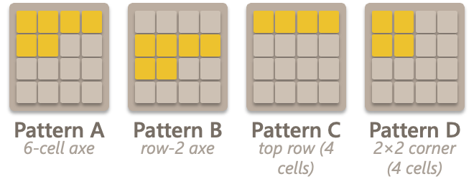
N-tuple — a concrete value computation
Read the patches · look up · sum
8
4
2
Read log₂ values at each patch
Each read → one weight
Pattern A
[3, 2, 1, 0, 2, 1]
axe top-left
w_A[idx_A] = +12.4
4
2
Pattern B
[2, 1, 0, 0, 1, 0]
axe row 2
w_B[idx_B] = +3.1
Pattern C
[3, 2, 1, 0]
top row
2
Pattern D
[3, 2, 2, 1]
2×2 corner
w_C[idx_C] = +4.2
(× 8 symmetries for A and B, × 4 for C and D — 24 reads total)
w_D[idx_D] = +6.5
… (× 24 reads in total)
Input board
V(board) ≈ 47.5
(sum of all 24 lookups)
Numbers are illustrative. Real weights are learned by playing thousands of games. Based on (Szubert & Jaśkowski 2014 onwards)
12 / 19
Notes:
Same idea as the DQN concrete slide — let me walk through what a real
value computation looks like.
We have this board on the left. To get its value, we read four patches.
PATTERN A — the top-left axe — covers six cells. We read their log-2
values: 8 is 3, 4 is 2, 2 is 1, empty is 0. So Pattern A reads as
[3, 2, 1, 0, 2, 1]. We pack those six numbers into a single integer index,
use it to look up Pattern A's table, and get back, say, +12.4.
Same thing for Patterns B, C, and D — we read the log-2 values, index into
the table, get a weight back.
PLUS: each of the four patches is looked up at every dihedral image of
itself. Pattern A and B have 8 unique images each. Pattern C and D have
4 each (they're themselves symmetric, so half their orbit collapses).
Total: 24 lookups per board.
Sum all 24 reads — V(board) ≈ 47.5.
That single number is how the n-tuple measures "how good is this board."
To pick a move at evaluation time, it tries each swipe, computes V of the
resulting board, and picks the highest one.
The weights themselves — those +12.4, +3.1, etc. — start at zero and get
learned by playing 10,000 games. The numbers shown are illustrative.

Slide 13
N-tuple — one training step
Pick · step · pick · update — no buffer, no batches, no gradient descent
1
2
3
4
Pick greedy move
Step the env
Pick next move
TD update
Try each legal swipe Score by r + V(after) Keep the best. Get a_t, r_t, after_t.
Apply move → after_t Spawn random tile → next board s_{t+1}
Repeat step 1 on s_{t+1}. Get a_{t+1}, r_{t+1}, after_{t+1}.
δ = r_{t+1} + V(after_{t+1}) − V(after_t) Add α·δ to all 24 weights that made up V(after_t).
Each update touches 24 numbers — microseconds per step
Trained for 10,000 games (~55 min on CPU)
13 / 19
Notes:
Here's the n-tuple's training step. It's much simpler than DQN.
STEP 1: pick the greedy move. We try each legal swipe, compute the
immediate reward plus V of the resulting afterstate, and keep the best.
"Afterstate" is the board state right after the deterministic slide-and-
merge, but *before* the random tile spawn — that's a key concept.
STEP 2: actually apply the move in the environment. The slide-and-merge
gives us "after_t". Then a random tile spawns, giving us the next board
s_{t+1}.
STEP 3: same procedure on s_{t+1} — find the next best move, get its
reward and afterstate.
STEP 4: this is the actual *learning*. We compute the TD error, delta:
"what should V(after_t) *have been*?" The answer, by the temporal-
difference equation, is r_{t+1} + V(after_{t+1}). The error is the
difference between target and current value. We add alpha times delta
to every one of the 24 weights that contributed to V(after_t).
Alpha is our learning rate — about 0.004 per weight, set so that the
*board-level* value update has magnitude alpha-base = 0.1.
That's it. No replay buffer. No batches. No gradient descent. Each
update touches 24 numbers and runs in microseconds. We trained for
10,000 games — about 55 minutes on CPU.
Note: we deliberately learn the value of *afterstates*, not states.
That keeps the random tile spawn out of our learning target — it's
just averaged out empirically by playing many games. That's one of the
n-tuple's structural advantages over DQN.

Slide 14
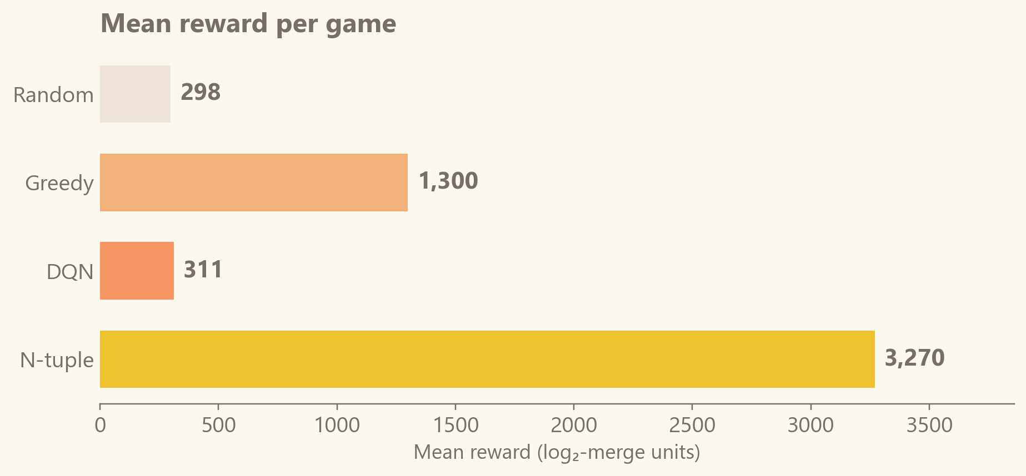
Results — the headline numbers
Random and greedy as baselines · DQN and N-tuple were trained
Random
Greedy
DQN
N-tuple
298
mean reward
1,300
mean reward
311
mean reward
3,270
mean reward
What stands out
• N-tuple wins by an order of magnitude on mean reward (3,270 vs 311 for DQN)
• DQN is effectively random: 311 vs 298 for uniform play
• Even greedy (no learning) beats DQN by 4×
• Scores are in log₂-merge units — about 5× smaller than the official 2048 score
14 / 19
Notes:
Let's talk results.
We trained the DQN for 5,000 games and the n-tuple for 10,000 games, then
evaluated both on a fresh test set of 300 games with seeds that were *not*
in training. Random and greedy don't train — they were just evaluated.
Look at the mean reward column on top. Random plays get about 298 points
per game on average. Greedy gets 1,300. The trained DQN gets… 311.
Basically tied with random.
The n-tuple gets 3,270 — an *order of magnitude* better than DQN.
A few things to notice. Even our hand-coded heuristic — with zero learning —
beats vanilla deep RL by 4× on this task. The n-tuple, with its hand-picked
patches and symmetry tricks, blows everything else away.
One housekeeping note: our scores are in "log2-merge units." We use the
log-2 of the new tile as the reward, not the tile's actual value. That
keeps reward magnitudes small. So 3,270 here would correspond to roughly
15,000–20,000 in standard 2048 scoring. The qualitative comparison is
unaffected.

Slide 15
Why did the linear method win?
Three things the n-tuple gets for free — before it ever starts learning
Right features beat raw data
Symmetry sharing = free 4-8× efficiency
Cleaner learning signal
The n-tuple's patches encode exactly what good 2048 play is about: • adjacency of tiles • corner structure • row monotonicity DQN has 256 raw numbers and no idea any of that matters.
A clever move in the top-left is a clever move in the top-right (mirrored), bottom-left (flipped), etc. The n-tuple updates all 8 variants at once. DQN learns each corner separately.
N-tuple learns afterstate values — the board before the random tile spawn. That keeps spawn noise out of the target. DQN learns the post-spawn board, so every target includes noise it couldn't have controlled.
15 / 19
Notes:
So *why* did the simpler method win? Three reasons, and they're all
about what the agent gets *for free* before it ever starts learning.
REASON ONE: the right features beat raw data. The n-tuple's hand-picked
patches encode exactly the structure that matters in 2048 — which tiles
are adjacent to which, what's in the corner, whether the top row is
sorted. DQN sees 256 raw numbers with no structure imposed on them, and
has to discover from scratch that any of this matters. With 5,000 games
of practice, it doesn't get there.
REASON TWO: the n-tuple gets symmetry for free. A clever move in the
top-left corner is, by symmetry, also a clever move in the other three
corners — just rotated or mirrored. The n-tuple updates all 8 symmetric
variants at once because they share weights. DQN has to relearn each
corner separately. That's roughly a 4-to-8× sample efficiency advantage.
REASON THREE: the learning signal is cleaner. The n-tuple learns values
of *afterstates* — the board after your swipe but before the random tile
spawn. That keeps the random spawn out of its learning target. DQN
learns the post-spawn board, so every learning target it computes includes
noise from a tile placement it had no control over.
All three of these are about REPRESENTATION, not network capacity. You
can have more parameters and still lose if you're looking at the wrong
thing.

Slide 16
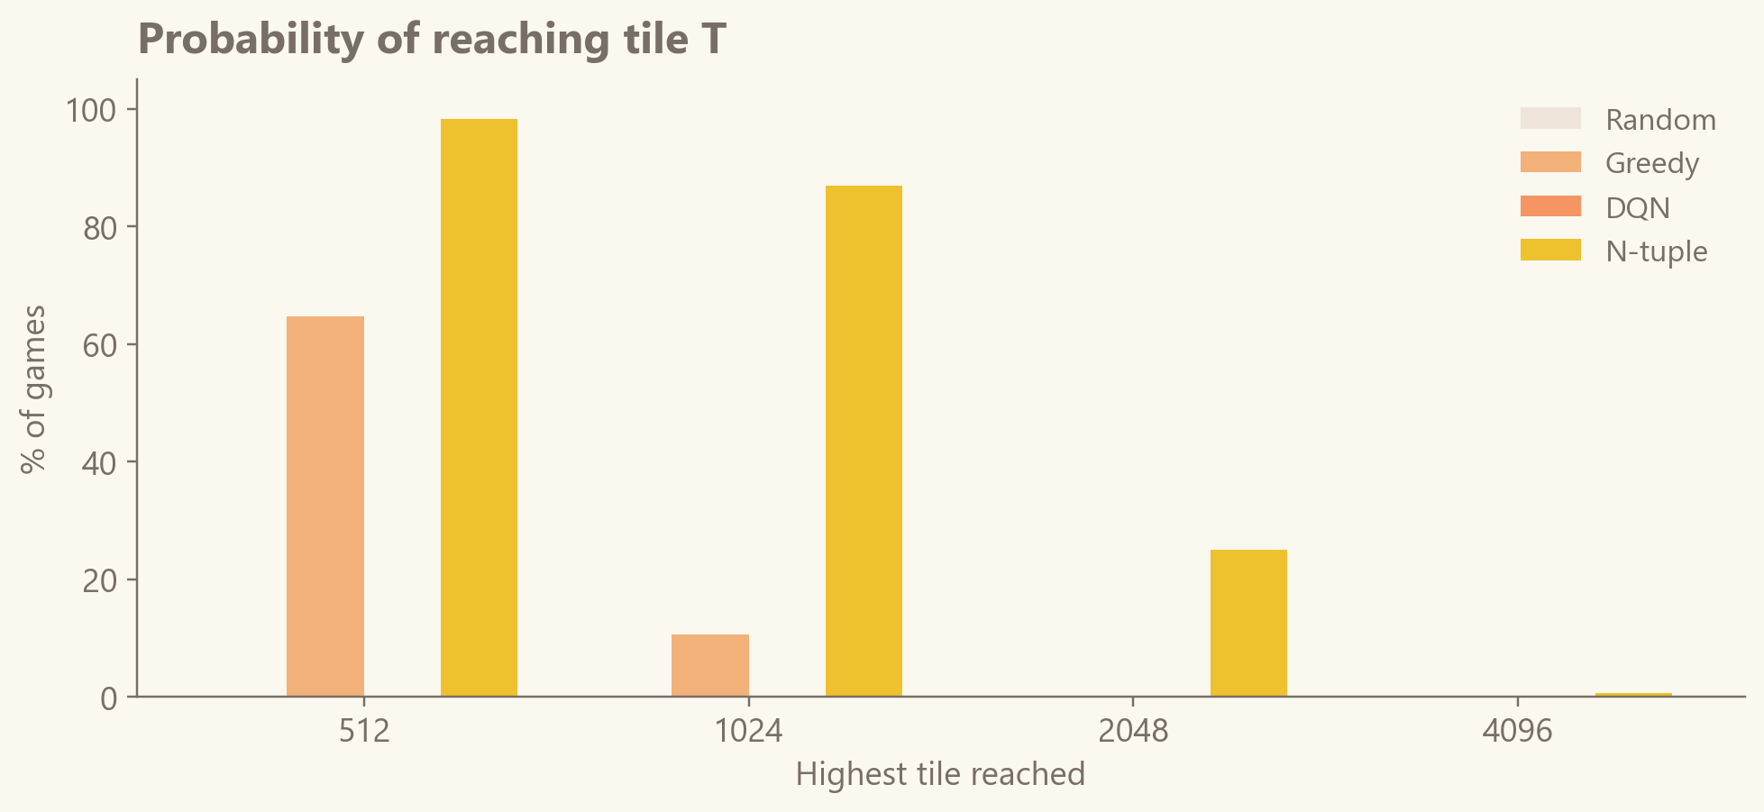
Results — how often each tile is reached
Max-tile probability tells the real story
Reading the chart
• N-tuple reaches 1024 in 87 % of games and 2048 in 25 %
• Greedy reaches 1024 in only 11 %, never 2048
• DQN never reaches 512 — same distribution as random
• The gap is not noise — it is structural
25 % of games end with the 2048 tile
(N-tuple, 300-game test set)
16 / 19
Notes:
Mean reward only tells half the story. This chart is more revealing —
it shows the *probability* that each agent reaches a given max tile.
Look at the n-tuple — the gold bars. It reaches the 1024 tile in 87 % of
games, and the 2048 tile — the win condition — in 25 % of games. One in
four games, it *actually wins*.
Greedy — the orange — reaches 1024 only 11 % of the time and never reaches
2048.
DQN — the red-orange — never even reaches 512. Its tile distribution is
indistinguishable from random.
The 25 % number — one in four games ending with the 2048 tile — is the
headline of the whole project. We built a working AI 2048 player, with no
deep learning at all.

Slide 17
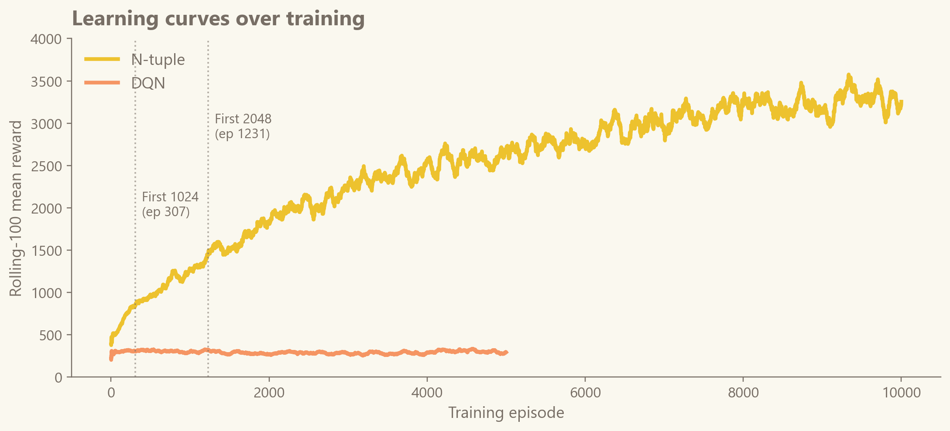
Results — how they learn over time
Rolling-100 mean reward across training episodes
What to notice
• N-tuple climbs steadily from ~500 to ~3,000
• DQN rises from ~100 to ~300 and flatlines
• First 1024 tile: episode 307
• First 2048 tile: episode 1,231
• DQN does not show any learning
N-tuple's reward keeps growing · DQN's plateaus
17 / 19
Notes:
This is how they learn over time. Both agents started knowing nothing.
The chart shows their rolling-100-episode mean reward as training
progresses.
The N-TUPLE — the gold line — climbs steadily from around 500 to around
3,000 over its 10,000 training games. The two dotted vertical lines
mark milestones: it built its first 1024 tile at episode 307, and its
first 2048 tile at episode 1,231. It's still improving at the end of
training — we could've kept going.
The DQN — the orange line — rises from about 100 to about 300 in the
first thousand episodes, then flatlines. It learned *something* —
roughly the difference between "obviously bad moves" and "average
moves" — but it hit a wall. Running it longer doesn't fundamentally
change the picture; the bottleneck is structural, not training time.
This is the cleanest visualization of "the n-tuple is actually learning;
DQN is stuck."

Slide 18
Watch them play
DQN on the left · N-tuple on the right · same starting state
DQN dies quickly · N-tuple stacks tiles in a corner
18 / 19
Notes:
Numbers are fine, but watching them play is more visceral.
This GIF shows both agents starting from the same initial board.
DQN on the left, n-tuple on the right.
You can see — DQN's game ends quickly. It's making moves that look
mostly reasonable, but the board fills up before it can build anything
significant. It dies around tile 128 or 256.
The n-tuple, on the right, does something very specific: it builds a
"snake" of tiles in one corner. That's the classic *human* strategy for
2048 — keep the biggest tile pinned in a corner and chain merges down
a snake of decreasing tiles next to it.
The n-tuple learned to do this on its own, just from the rewards.
Nobody told it "build a snake in a corner." That behaviour emerged
because the lookup-table patches happen to be sensitive to corner
arrangements, and the TD updates push the values up whenever a corner
snake leads to high reward.
[Let the GIF play out for a few seconds before clicking forward.]

Slide 19
Thanks for your attention
Questions?
2
4
16
8
Notes:
And that's it from us. Thanks for listening — happy to take questions
on any of it.
Some good prompts in case the audience is shy:
- "Why did you pick those four patches for the n-tuple?" → S&J 2014
paper's pattern set, picked by humans based on what matters in 2048.
- "How would you make DQN actually work here?" → CNN encoder, n-step
returns, prioritized replay, ~10× longer training budget.
- "What's the official 2048 score equivalent of 3,270 in your units?"
→ roughly 15,000–20,000 in standard scoring.
- "Is the n-tuple just a memo'd table — could it overfit?" → it
could in principle, but the dihedral symmetry sharing means each
weight is hit by many board configurations, and 16M weights vs.
millions of board configurations means it generalizes well in
practice.

Slide 20

Appendix — DQN in depth
Backup reference for questions: architecture, hyperparameters, and the five stabilisation tricks
Architecture & hyperparameters
The five stabilisation tricks
• Network: fully-connected MLP — 256 → 512 → 256 → 4, ReLU
• Input: 16 board cells × 16 one-hot value buckets = 256 floats
• Output: 4 Q-values, one per swipe (↑ → ↓ ←)
• Loss: Smooth-L1 (Huber) — robust to outlier TD errors
• Optimiser: Adam, learning rate 5e-4 (= 0.0005)
• Discount factor: γ = 0.99
• Replay buffer: 100,000 transitions (ring buffer)
• Warm-up: 1,000 steps collected before learning starts
• Mini-batch: 512 transitions per gradient step
• Learn frequency: 1 gradient step every 4 environment steps
• Target-network sync: every 1,000 gradient steps
• Exploration: ε-greedy, ε decays 1.0 → 0.05
• Reward: log₂ of the merged tile, then × 0.1 scaling
• Training budget: 5,000 games (≈ 25 min on Apple-MPS)
1. Target network a frozen copy of the network computes the target, synced every 1,000 steps — stops the target from moving every step.
2. Double-DQN the online net picks the next action, the target net scores it — removes the upward bias of the max operator.
3. Reward scaling log₂ encoding plus a × 0.1 multiplier — keeps rewards on a stable scale in both early and late game.
4. ε-greedy exploration act randomly with probability ε — forces the agent to keep exploring instead of only exploiting.
5. Action masking illegal swipes’ Q-values are clamped to −1e9 — the agent never wastes a move on a no-op swipe.
Why the tricks are needed — basic DQN is unstable for three reasons: (1) it bootstraps off its own predictions, so the target keeps moving; (2) the max over noisy Q-estimates is biased upward; (3) reward magnitudes vary wildly across a game.

